Slide 1
Assessment Workflow Answer
Notes:
https://www.kaggle.com/code/vamshikreddy/predictive-maintenance-using-lstm

Slide 2
Workflow steps
Data Loading & Preprocessing
Data Visualization
Model Training and prediction
Model evaluation
Notes:
https://www.kaggle.com/code/winternguyen/water-pump-maintenance-shutdown-prediction/data

Slide 3
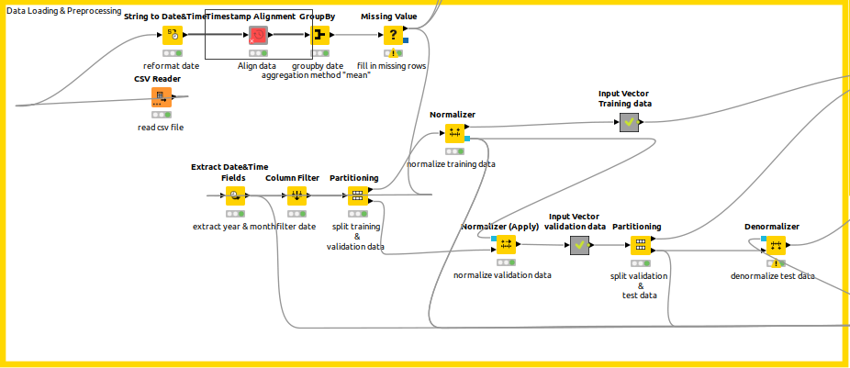
Data Loading & Preprocessing

Slide 4
Data Loading & Preprocessing
CSV Reader - to read csv file
String to Date - reformat Date(str) to date format
Timestamp Alignment - to align data by month
Groupby - groupby duplicate date by mean as the aggregation method
Missing value - fill all the missing value using Linear Interpolation method
Extract date & time field - extract year, month and day to add more features
Column filter - filter all unnecessary column
Partitioning - split training and validation data
Normalizer - Normalize the data by Gaussian Method
Prepare input vector for Keras Model for both training and validation dataset
Partitioning - split validation and test data

Slide 5
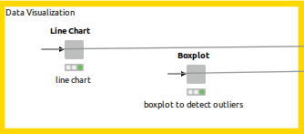
Data Visualization
Visualize all the data with line chart to see trend and pattern of the features
Box plot is used to detect the outliers in the data

Slide 6
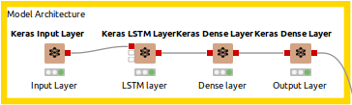
Model Architecture
The model architecture is:-
Input layer
LSTM Layer
Dense Layer
Output Layer

Slide 7
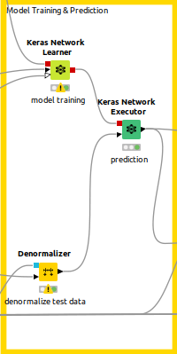
Model Training & prediction
Keras Network Learner - to train the model
Metric loss (MSE)
Optimizers ‘Adam’
Batch size 32
Epochs 50
Early stopping to avoid overfitting with monitoring the training loss with patience of 3
Denormalizer - denormalize the test data
Keras Network Executor - to predict the target value

Slide 8
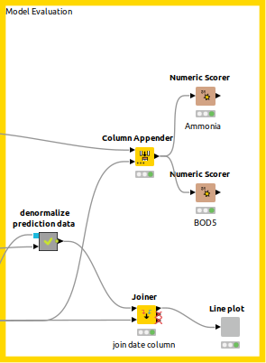
Model Evaluation
Denormalize the test data
Numeric scorer

